Slide 1

PROJECT | Natural Language Processing Challenge
Group 2
Alvaro Lacave Ricardo Frías

Slide 2
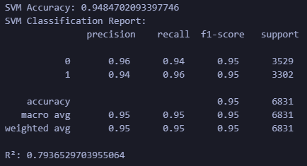
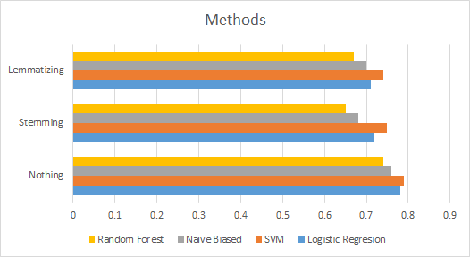

SVM (no preprocessing)
R2: 0.79
Accuracy: 0.95
SVM
Other models / embedding

Slide 3
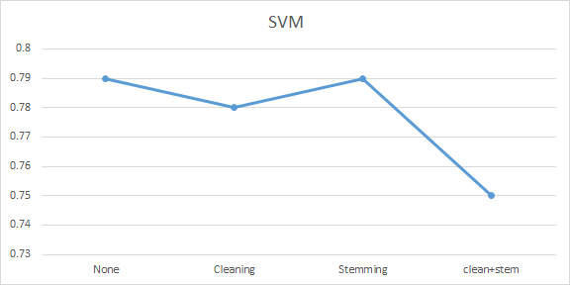
Methods (preprocessing)

Slide 4
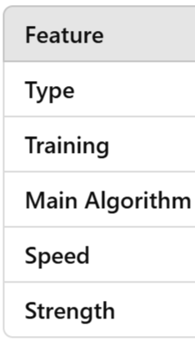
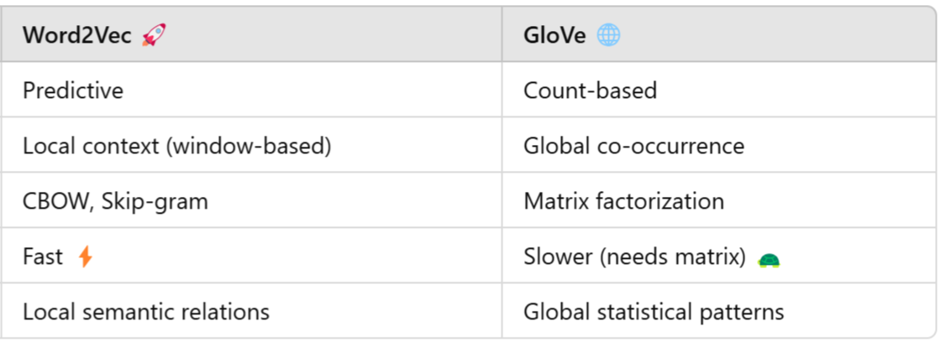
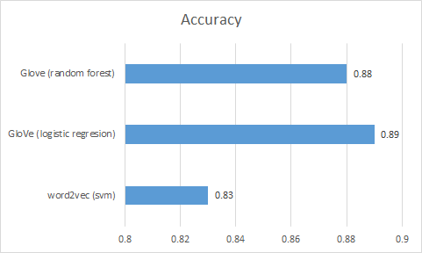
Methods (embedding)

Slide 5
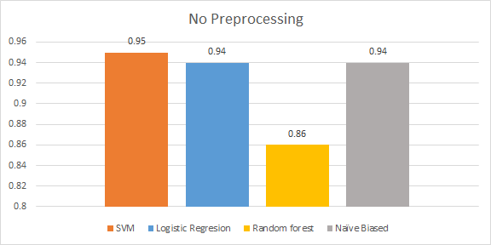

Methods (models)
SVM
Logistic Regresion
Random Forest
Naive Bayes

Slide 6
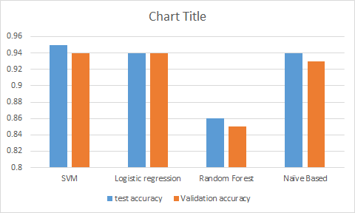

Testing vs Validation accuracy
Small Gap
Well-Generalized Models
Random forest
overfitting
lack generalization
SVM and Logistic regression
consistent performance

Slide 7
Takeaways
Recap / conclusions: Preprocessing in this case was a counterproductive strategy.
Embeddings didn´t improve either.
Not always the most advanced models are the best for every task.
Challenges: Have good capacity to choose the right path between many models and preprocessing options.
Many different models and results.
Key learnings: Have good organization between models and results. This way is much easier to see what works better. Sometimes simpler solutions work better than sophisticated approaches.

